Slide 1
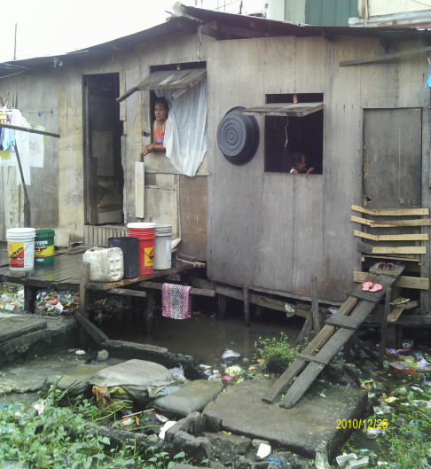
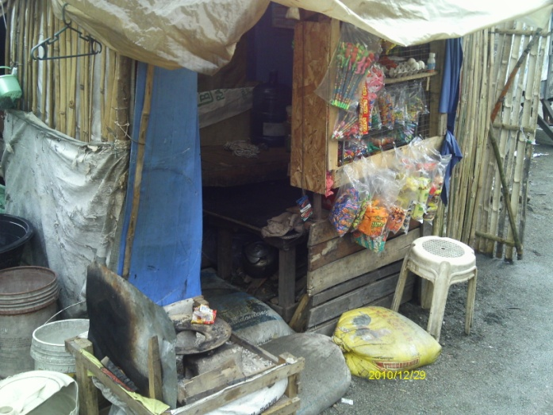
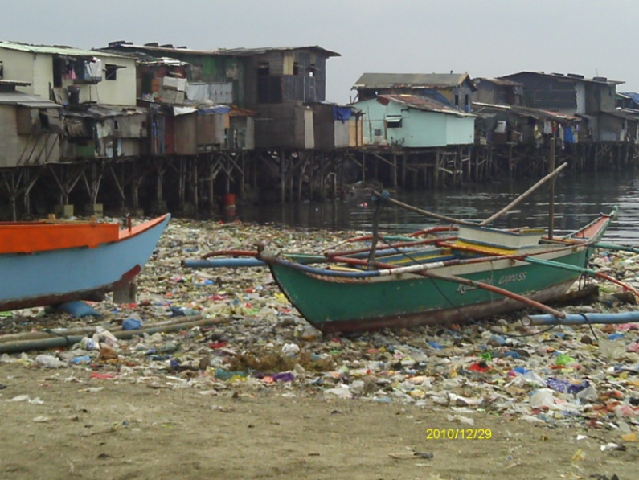
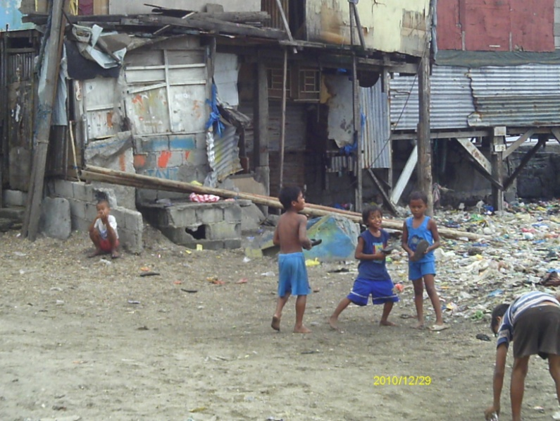
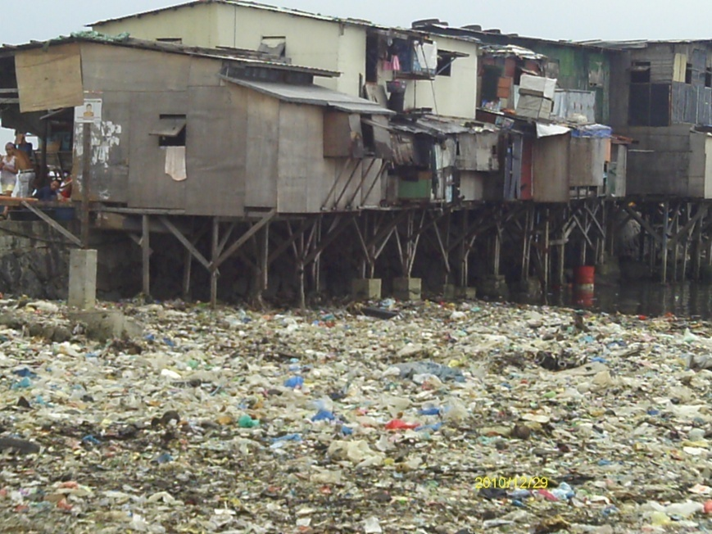
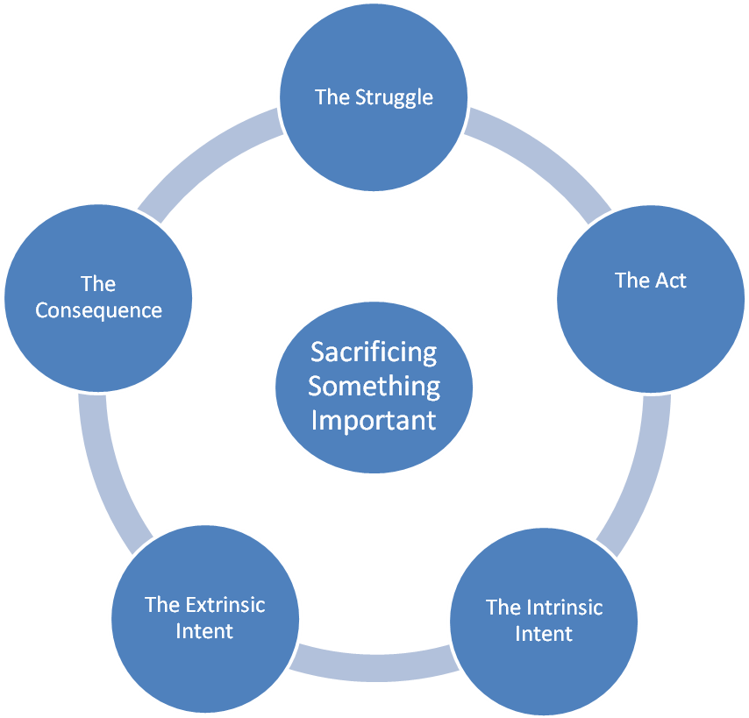
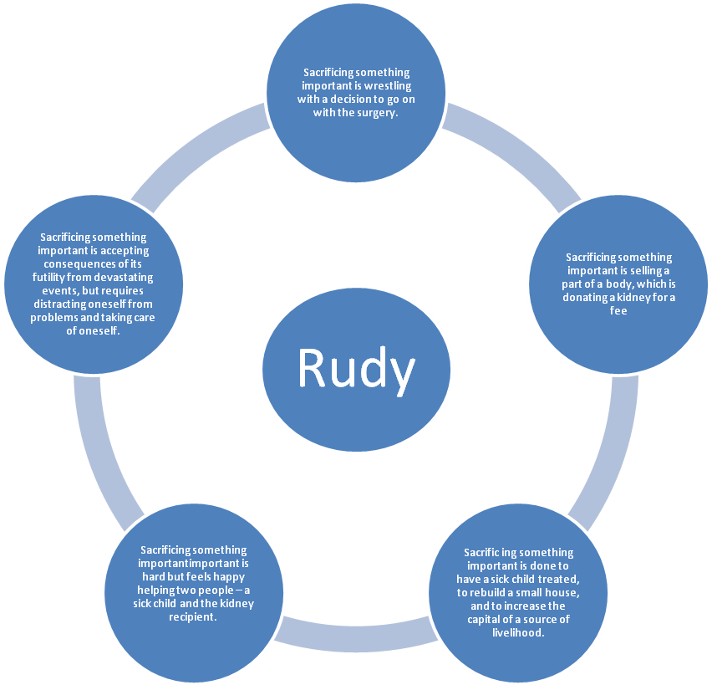
Sacrificing Something Important: The Lived Experience of Compensated Kidney Donors in the Philippines
MEDEL SALVADOR-PAGUIRIGAN, EdD, RN, CNN, CNE
New York University College of Nursing, NY 10003, USA
Abstract
Setting
Structure
The purpose of this study is to identify the structure of the universal phenomenon of sacrificing something important among the compensated kidney donors (healthy individuals who opt to undergo voluntary nephrectomy for money) in the Philippines. This study was guided by the van Manen Phenomenological Method to collect qualitative data by conducting in-depth face-to-face interviews with 13 participants in the town of Baseco, in Manila, Philippines, the hub of the organ trade. Raw data were coded, analyzed, and categorized to answer the research question. The structure of sacrificing something important among the compensated kidney donors in the Philippines emerges from the extrinsic intent of adversity and the intrinsic intent of altruism, which are instrumental to the struggle of making a difficult decision, emerging in the act with reciprocation, and although resulting in the consequences of health deterioration and loss, resilience makes bouncing back possible. The ultimate goal is that the knowledge illuminated from this study, used cautiously, will provide insight on how these lived experiences can influence nursing practice, education, and future research.
wrestling to make a decision
Rudy’s Story
According to 48-year-old Rudy, “it’s always hard to sacrifice something that is important to you.” He added, “it’s easier if your sacrifice helped someone.” He learned this after his son contracted “tuberculosis of the bone.” This, made him decide to undergo a kidney “transplant” (donation) for 80,000 PHP (1,818 USD) in 1995. His health status before surgery was good. Now he claims to be weaker and experiences fatigue easily. The payment was used to treat his son, rebuild a house, and put up a small convenience store in Baseco. His son got better. After some time, however, a storm destroyed their home and store. He built a new home, which was destroyed in a fire. Meanwhile, his only daughter caught dengue fever and died. He said, “It hurts in the sense that the money used in that came from selling my kidney would suddenly disappear.” As a result, his wife developed some psychological problems. To remedy this, he opened a small convenience store where she could focus her thoughts on something else. As of now, he is also trying to set his sons straight so that they wouldn't follow in his footsteps. Rudy and his family are currently living in a house from Habitat for Humanity, which he has yet to pay off. He supports four children, his wife, and three other relatives. Rudy manages by distracting himself. He is happy with the help he provided his son as well as the kidney recipient. Left with one kidney, he takes care of himself by staying clear of salty foods and alcohol. He says, “I just think of something else, because I might go crazy if I think about all our problems regarding rent, food, etc.”
health deterioration, loss and resilience
reciprocation
Research Question
What is the structure of sacrificing something important among the compensated kidney donors in the Philippines?
Demographic Information
Characteristic | Mean
Age at interview (years) | 39.8
Age at nephrectomy (years) | 30
Approximate monthly income | $162
Number of household | 6
Amount paid for kidney donation | $2,174
Rudy’s Linguistic Transformation
poverty and adversity
altruism
Implications
The implication for nursing education is toward creating a curriculum that is culturally competent that addresses the needs of the vulnerable and marginalized population utilizing a balanced nursing paradigm. Awareness campaigns, continuing dialogues about current policies, and implementation of evidence-based programs are the implications in the area of nursing practice. Supporting research on the quality of life and the increasing donor pool are the main implications for nursing research.

